Slide 1


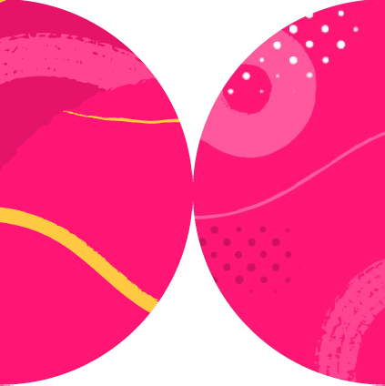

Understanding Playwright’s Core Concepts

Slide 2

Overview
test() function
Fixtures
expect() for assertions async-await syntax tips

Slide 3

import { expect } from '@playwright/test’;
await expect(locator).toBeEnabled() await expect(locator).toBeEditable() await expect(locator).toBeVisible()

Slide 4



isVisible(element)
await expect(locator).toBeVisible()

Slide 5
// This takes time...
async function fetchData() {...}
// wait before moving on
const data = await fetchThing();

Slide 6


Things That Take Time
await page.goto('url');
await page.getByRole('button').click(); await expect(result).toContainText('...');

Slide 7
test('Unique test name in file', async () => {
});

Slide 8
test('Unique test name in file', async ({ page }) => {
await page.goto('url');
// with retries
await expect(page).toHaveTitle('Welcome');
});
title(): Promise<string>;

Slide 9
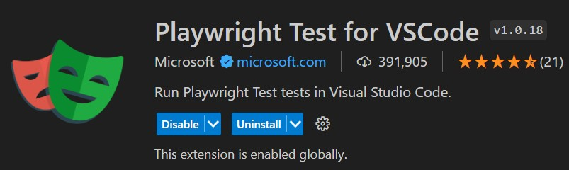
npx | playwright | test
npx | playwright | test | tests/your-file.spec.ts
npx | playwright | test | tests/your-dir/

Slide 10

Up Next:
Using Locators

